Slide 1

Data Science & Machine Learning in Finance: Matrix Calculus
Hadi Movaghari
2022-2023

Slide 2
Outline
Section 1: Vectors
Section 2: Matrices
Section 3: Ordinary Least Squares (OLS)
Data Science & Machine Learning in Finance: Matrix Calculus
University of Glasgow
2022-2023

Slide 3
Section 1
Vectors

Slide 4
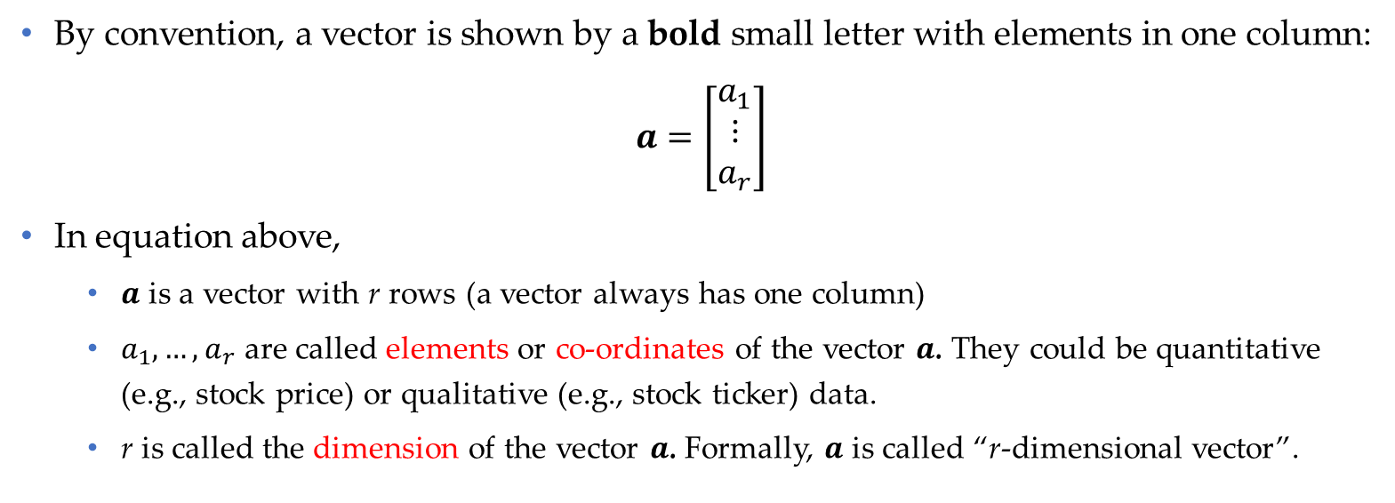
Notation
By convention, a vector is shown by a bold small letter with elements in one column:
$$a=\left[\begin{matrix}a_{1} \\ ⋮ \\ a_{r}\end{matrix}\right]$$
In equation above,
$a$ is a vector with r rows (a vector always has one column)
$a_{1},…,a_{r}$ are called elements or co-ordinates of the vector $a$. They could be quantitative (e.g., stock price) or qualitative (e.g., stock ticker) data.
r is called the dimension of the vector $a$. Formally, $a$ is called “r-dimensional vector”.
Note: The order of elements in a vector is important. Changing the order of the elements create a new vector.
Data Science & Machine Learning in Finance: Matrix Calculus
University of Glasgow
2022-2023

Slide 5
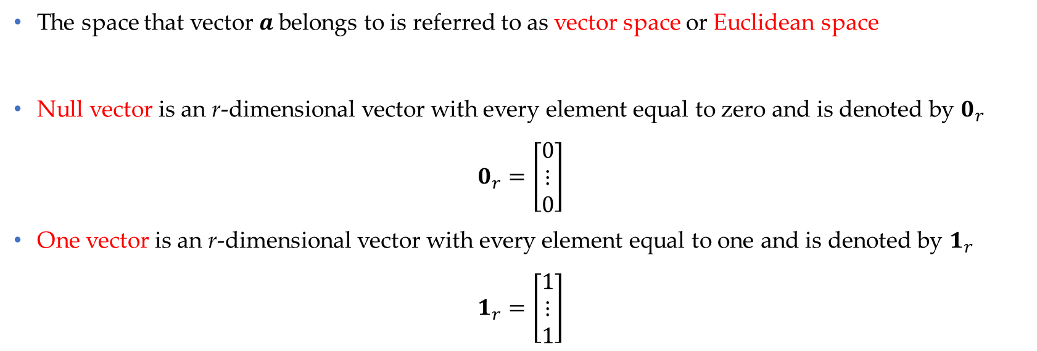
Notation (Cont’d)
The space that vector $a$belongs to is referred to as vector space or Euclidean space
Null vector is an r-dimensional vector with every element equal to zero and is denoted by $0_{r}$
$$0_{r}=\left[\begin{matrix}0 \\ ⋮ \\ 0\end{matrix}\right]$$
One vector is an r-dimensional vector with every element equal to one and is denoted by $1_{r}$
$$1_{r}=\left[\begin{matrix}1 \\ ⋮ \\ 1\end{matrix}\right]$$
Data Science & Machine Learning in Finance: Matrix Calculus
University of Glasgow
2022-2023

Slide 6

Mathematical operation on vectors
Equality
Two vectors are equal if and only if (or iff) their entries are equal element-by-element
Example
$$\left[\begin{matrix}1 \\ 2 \\ 3\end{matrix}\right]=\left[\begin{matrix}1 \\ 2 \\ 3\end{matrix}\right], \left[\begin{matrix}1 \\ 3 \\ 3\end{matrix}\right]≠\left[\begin{matrix}1 \\ 2 \\ 3\end{matrix}\right]$$
Note: we cannot compare to vectors with different dimensions!
Data Science & Machine Learning in Finance: Matrix Calculus
University of Glasgow
2022-2023

Slide 7

Mathematical operation on vectors (Cont’d)
Strict inequality
We say vector $a$ is greater than vector $b$ if and only if entries in $a$ are greater than entries in $b$ element-by-element:
Example
$$\left[\begin{matrix}1 \\ 1 \\ 3\end{matrix}\right]>\left[\begin{matrix}0 \\ 0 \\ 2\end{matrix}\right]$$
Note: If strict inequality does not hold even only for one of the elements, we cannot compare the two vectors with strict inequality.
Data Science & Machine Learning in Finance: Matrix Calculus
University of Glasgow
2022-2023

Slide 8

Mathematical operation on vectors (Cont’d)
Weak inequality
We say vector $a$ is greater than or equal to vector $b$ if and only if entries in $a$ are greater than or equal to the entries in $b$ element-by-element:
Example
$$\left[\begin{matrix}1 \\ 1 \\ 3\end{matrix}\right]≥\left[\begin{matrix}0 \\ 1 \\ 2\end{matrix}\right]$$
Note: If weak inequality does not hold even only for one of the elements, we cannot compare the two vectors with weak inequality.
Data Science & Machine Learning in Finance: Matrix Calculus
University of Glasgow
2022-2023

Slide 9
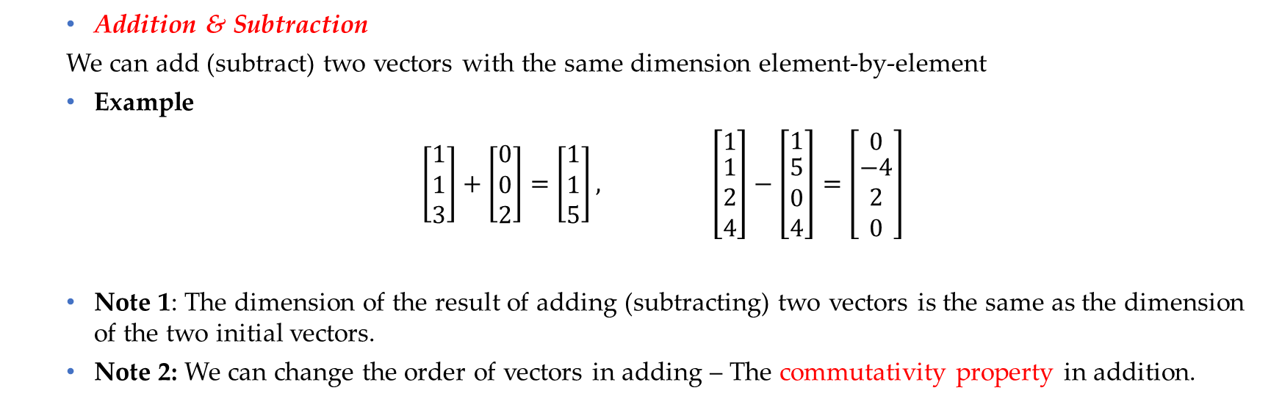
Mathematical operation on vectors (Cont’d)
Addition & Subtraction
We can add (subtract) two vectors with the same dimension element-by-element
Example
$\left[\begin{matrix}1 \\ 1 \\ 3\end{matrix}\right]+\left[\begin{matrix}0 \\ 0 \\ 2\end{matrix}\right]=$ $\left[\begin{matrix}1 \\ 1 \\ 5\end{matrix}\right], \left[\begin{matrix}1 \\ \begin{matrix}1 \\ 2 \\ 4\end{matrix}\end{matrix}\right]−\left[\begin{matrix}1 \\ \begin{matrix}5 \\ 0 \\ 4\end{matrix}\end{matrix}\right]=$ $\left[\begin{matrix}0 \\ \begin{matrix}−4 \\ 2 \\ 0\end{matrix}\end{matrix}\right]$
Note 1: The dimension of the result of adding (subtracting) two vectors is the same as the dimension of the two initial vectors.
Note 2: We can change the order of vectors in adding – The commutativity property in addition.
Data Science & Machine Learning in Finance: Matrix Calculus
University of Glasgow
2022-2023

Slide 10

Mathematical operation on vectors (Cont’d)
Multiplication by a scalar
We can multiply a scalar in all elements of a vector
Example
(-5)$\left[\begin{matrix}1 \\ 0 \\ 3\end{matrix}\right]=\left[\begin{matrix}−5 \\ 0 \\ −15\end{matrix}\right]$
Data Science & Machine Learning in Finance: Matrix Calculus
University of Glasgow
2022-2023

Slide 11
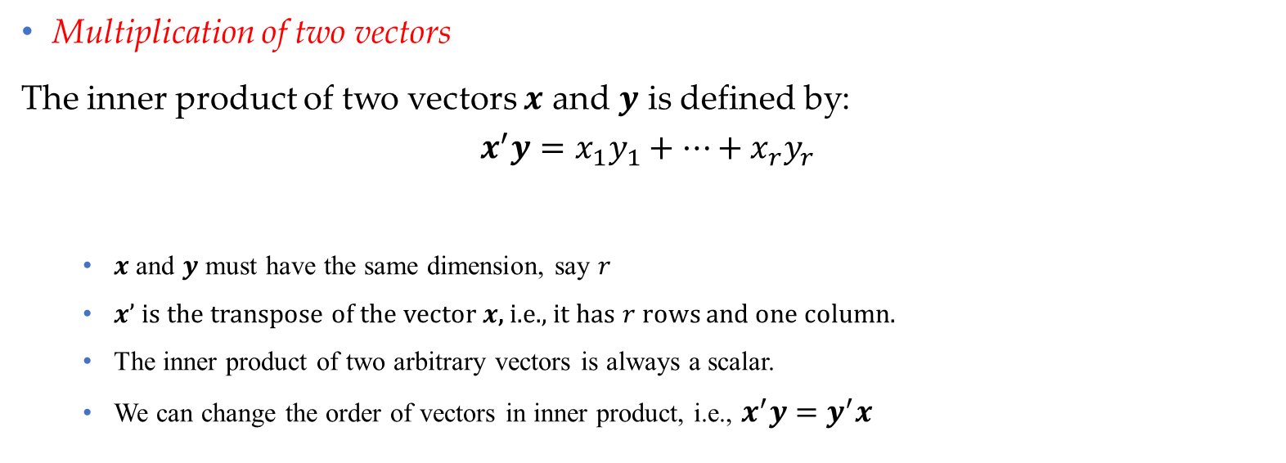
Mathematical operation on vectors (Cont’d)
Multiplication of two vectors
The inner product of two vectors $x$ and $y$ is defined by:
$$x^{′}y=x_{1}y_{1}+…+x_{r}y_{r}$$
$x$ and $y$ must have the same dimension, say $r$
$x’$ is the transpose of the vector $x$, i.e., it has $r$ rows and one column.
The inner product of two arbitrary vectors is always a scalar.
We can change the order of vectors in inner product, i.e., $x^{′}y=y^{′}x$
Data Science & Machine Learning in Finance: Matrix Calculus
University of Glasgow
2022-2023

Slide 12
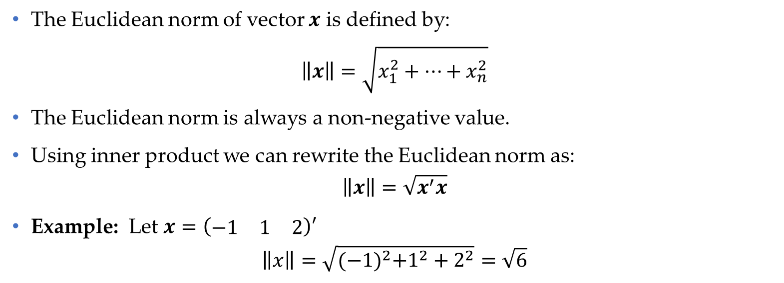
Euclidean Norm
The Euclidean norm of vector $x$ is defined by:
$$\left\|x\right\|=\sqrt{x_{1}^{2}+…+x_{n}^{2}}$$
The Euclidean norm is always a non-negative value.
Using inner product we can rewrite the Euclidean norm as:
$$\left\|x\right\|=\sqrt{x^{′}x}$$
Example: Let $x=\left(\begin{matrix}−1 & 1 & 2\end{matrix}\right)′$
$$\left\|x\right\|=\sqrt{{(−1)}^{2}+1^{2}+2^{2}}=\sqrt{6}$$
Data Science & Machine Learning in Finance: Matrix Calculus
University of Glasgow
2022-2023

Slide 13
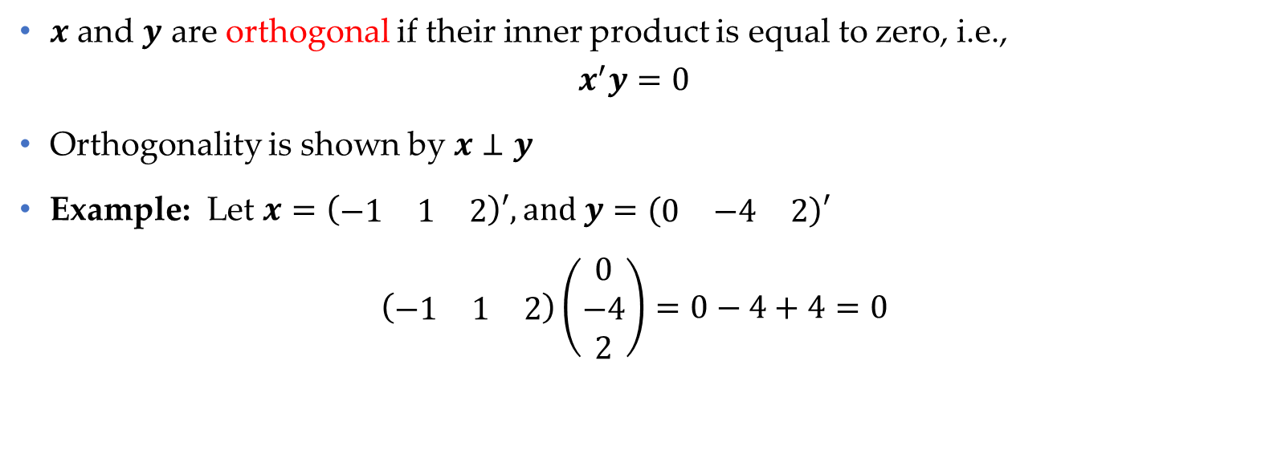
Orthogonality
$x$ and $y$ are orthogonal if their inner product is equal to zero, i.e.,
$$x^{′}y=0$$
Orthogonality is shown by $x⊥y$
Example: Let $x=\left(\begin{matrix}−1 & 1 & 2\end{matrix}\right)′, and y=(\begin{matrix}0 & −4 & 2\end{matrix})′$
$$\left(\begin{matrix}−1 & 1 & 2\end{matrix}\right)\left(\begin{matrix}0 \\ −4 \\ 2\end{matrix}\right)=0−4+4=0$$
Data Science & Machine Learning in Finance: Matrix Calculus
University of Glasgow
2022-2023

Slide 14
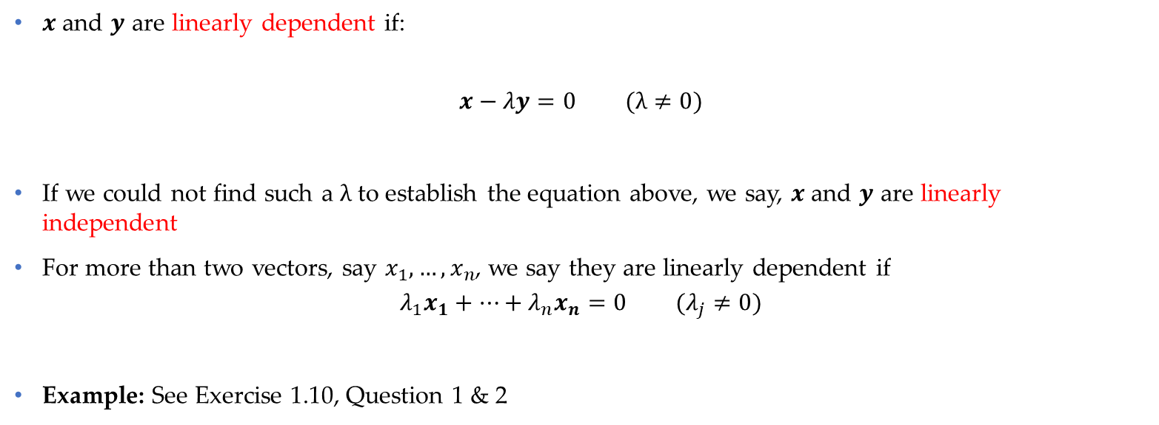
Linear independence
$x$ and $y$ are linearly dependent if:
$$x−λy=0 (λ≠0)$$
If we could not find such a $λ$ to establish the equation above, we say, $x$ and $y$ are linearly independent
For more than two vectors, say $x_{1},…,x_{n}$, we say they are linearly dependent if
$$λ_{1}x_{1}+…+λ_{n}x_{n}=0 (λ_{j}≠0)$$
Example: See Exercise 1.10, Question 1 & 2
Data Science & Machine Learning in Finance: Matrix Calculus
University of Glasgow
2022-2023

Slide 15
Section 2
Matrix

Slide 16
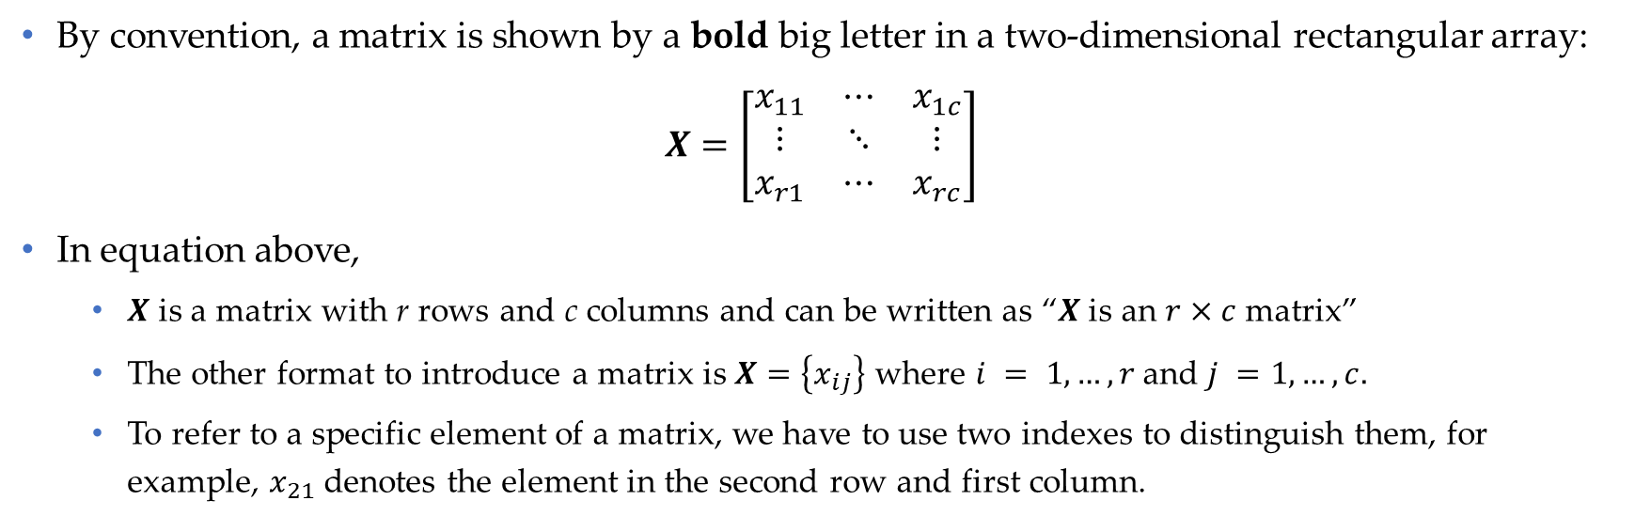
Notation
By convention, a matrix is shown by a bold big letter in a two-dimensional rectangular array:
$$X=\left[\begin{matrix}x_{11} & ⋯ & x_{1c} \\ ⋮ & ⋱ & ⋮ \\ x_{r1} & ⋯ & x_{rc}\end{matrix}\right]$$
In equation above,
$X$ is a matrix with r rows and c columns and can be written as “$X$ is an $r×c$ matrix”
The other format to introduce a matrix is $X=\left\{x_{ij}\right\}$ where $i = 1,…, r$and $j =1,…,c.$
To refer to a specific element of a matrix, we have to use two indexes to distinguish them, for example, $x_{21}$ denotes the element in the second row and first column.
Note: In a broader view, an r-dimensional vector can be considered as an $r×1$ matrix.
Data Science & Machine Learning in Finance: Matrix Calculus
University of Glasgow
2022-2023

Slide 17
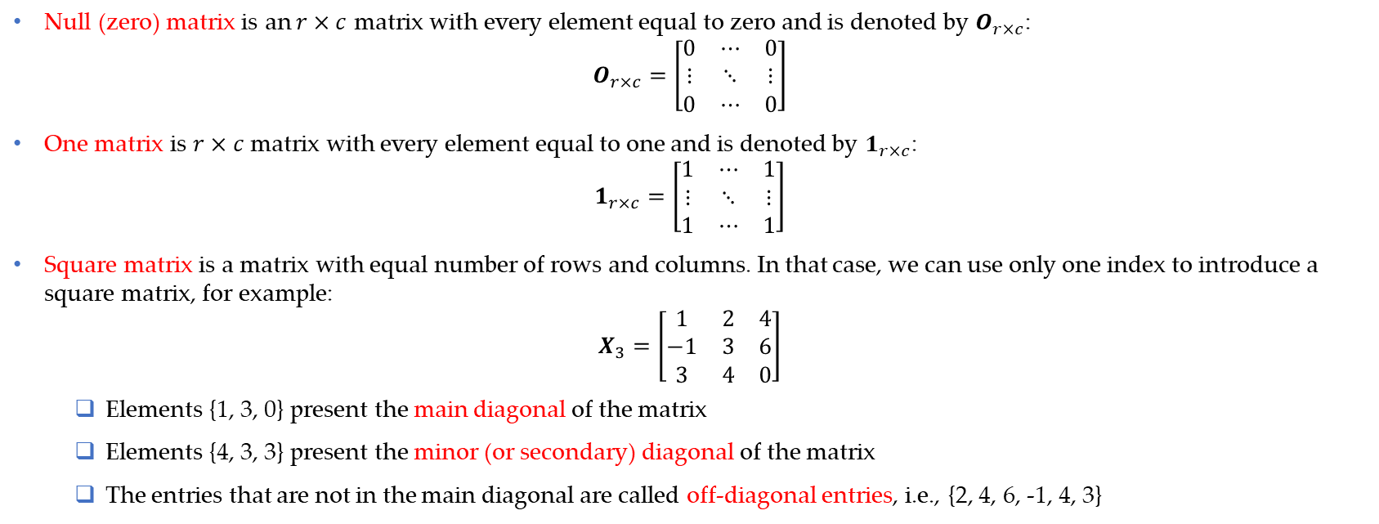
Special matrices
Null (zero) matrix is an $r×c$ matrix with every element equal to zero and is denoted by $O_{r×c}$:
$$O_{r×c}=\left[\begin{matrix}0 & ⋯ & 0 \\ ⋮ & ⋱ & ⋮ \\ 0 & ⋯ & 0\end{matrix}\right]$$
One matrix is $r×c$ matrix with every element equal to one and is denoted by $1_{r×c}$:
$$1_{r×c}=\left[\begin{matrix}1 & ⋯ & 1 \\ ⋮ & ⋱ & ⋮ \\ 1 & ⋯ & 1\end{matrix}\right]$$
Square matrix is a matrix with equal number of rows and columns. In that case, we can use only one index to introduce a square matrix, for example:
$$X_{3}=\left[\begin{matrix}1 & 2 & 4 \\ −1 & 3 & 6 \\ 3 & 4 & 0\end{matrix}\right]$$
Elements {1, 3, 0} present the main diagonal of the matrix
Elements {4, 3, 3} present the minor (or secondary) diagonal of the matrix
The entries that are not in the main diagonal are called off-diagonal entries, i.e., {2, 4, 6, -1, 4, 3}
Data Science & Machine Learning in Finance: Matrix Calculus
University of Glasgow
2022-2023

Slide 18
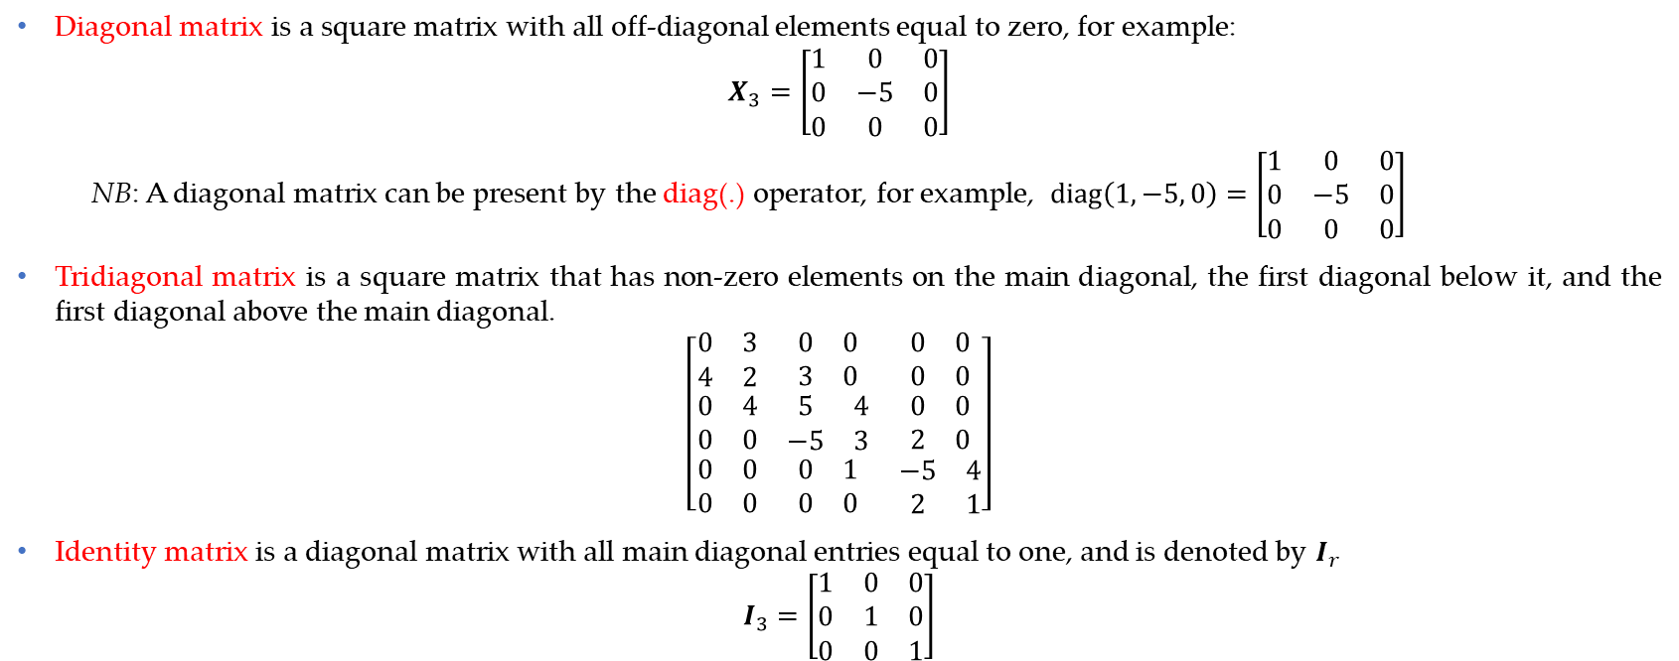
Special matrices (Cont’d)
Diagonal matrix is a square matrix with all off-diagonal elements equal to zero, for example:
$$X_{3}=\left[\begin{matrix}1 & 0 & 0 \\ 0 & −5 & 0 \\ 0 & 0 & 0\end{matrix}\right]$$
NB: A diagonal matrix can be present by the diag(.) operator, for example, $diag\left(1, −5, 0\right)=\left[\begin{matrix}1 & 0 & 0 \\ 0 & −5 & 0 \\ 0 & 0 & 0\end{matrix}\right]$
Tridiagonal matrix is a square matrix that has non-zero elements on the main diagonal, the first diagonal below it, and the first diagonal above the main diagonal.
$$\left[\begin{matrix}\begin{matrix}0 & 3 \\ 4 & 2\end{matrix} & \begin{matrix}0 & 0 \\ 3 & 0\end{matrix} & \begin{matrix}0 & 0 \\ 0 & 0\end{matrix} \\ \begin{matrix}0 & 4 \\ 0 & 0\end{matrix} & \begin{matrix}5 & 4 \\ −5 & 3\end{matrix} & \begin{matrix}0 & 0 \\ 2 & 0\end{matrix} \\ \begin{matrix}0 & 0 \\ 0 & 0\end{matrix} & \begin{matrix}0 & 1 \\ 0 & 0\end{matrix} & \begin{matrix}−5 & 4 \\ 2 & 1\end{matrix}\end{matrix}\right]$$
Identity matrix is a diagonal matrix with all main diagonal entries equal to one, and is denoted by $I_{r}$
$$I_{3}=\left[\begin{matrix}1 & 0 & 0 \\ 0 & 1 & 0 \\ 0 & 0 & 1\end{matrix}\right]$$
Data Science & Machine Learning in Finance: Matrix Calculus
University of Glasgow
2022-2023

Slide 19
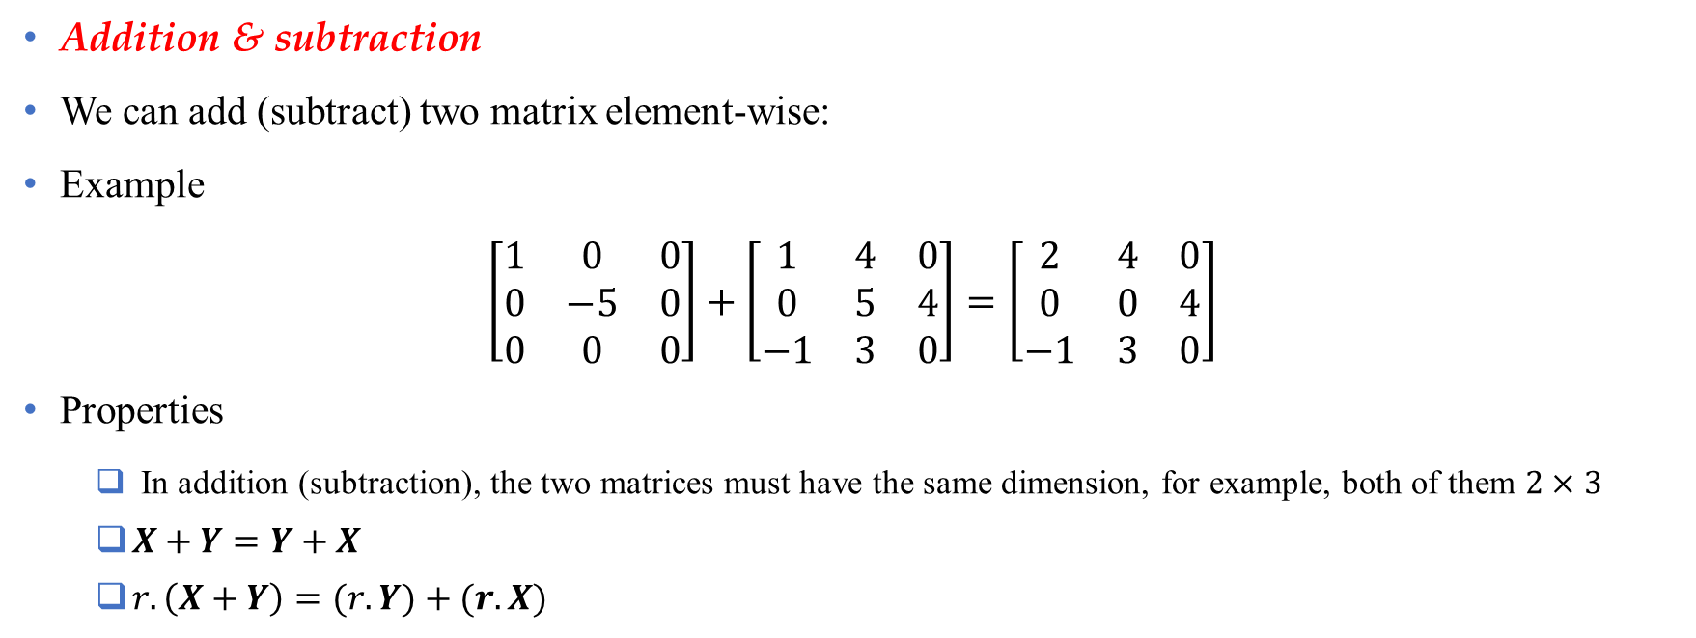
Mathematical operations on matrix
Addition & subtraction
We can add (subtract) two matrix element-wise:
Example
$$\left[\begin{matrix}1 & 0 & 0 \\ 0 & −5 & 0 \\ 0 & 0 & 0\end{matrix}\right]+\left[\begin{matrix}1 & 4 & 0 \\ 0 & 5 & 4 \\ −1 & 3 & 0\end{matrix}\right]=\left[\begin{matrix}2 & 4 & 0 \\ 0 & 0 & 4 \\ −1 & 3 & 0\end{matrix}\right]$$
Properties
In addition (subtraction), the two matrices must have the same dimension, for example, both of them $2×3$
$X+Y=Y+X$
$r.\left(X+Y\right)=(r.Y)+(r.X)$
Data Science & Machine Learning in Finance: Matrix Calculus
University of Glasgow
2022-2023

Slide 20
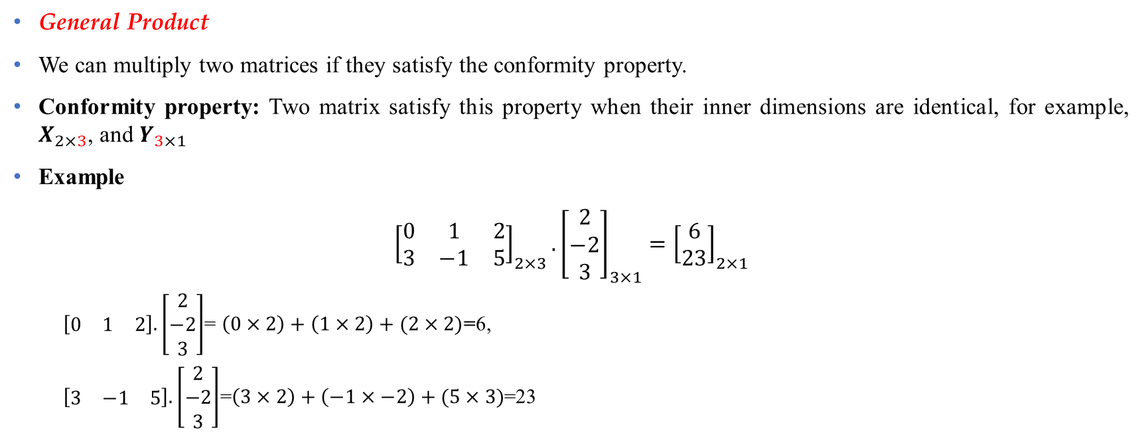
Mathematical operations on matrix (Cont’d)
General Product
We can multiply two matrices if they satisfy the conformity property.
Conformity property: Two matrix satisfy this property when their inner dimensions are identical, for example, $X_{2×3}$, and $Y_{3×1}$
Example
$${\left[\begin{matrix}0 & 1 & 2 \\ 3 & −1 & 5\end{matrix}\right]}_{2×3}. {\left[\begin{matrix}2 \\ −2 \\ 3\end{matrix}\right]}_{3×1}={\left[\begin{matrix}6 \\ 23\end{matrix}\right]}_{2×1}$$
$\left[\begin{matrix}0 & 1 & 2\end{matrix}\right].\left[\begin{matrix}2 \\ −2 \\ 3\end{matrix}\right]$= $\left(0×2\right)+\left(1×2\right)+(2×2)$=6,
$\left[\begin{matrix}3 & −1 & 5\end{matrix}\right].\left[\begin{matrix}2 \\ −2 \\ 3\end{matrix}\right]$=$\left(3×2\right)+\left(−1×−2\right)+(5×3)$=23
Data Science & Machine Learning in Finance: Matrix Calculus
University of Glasgow
2022-2023

Slide 21
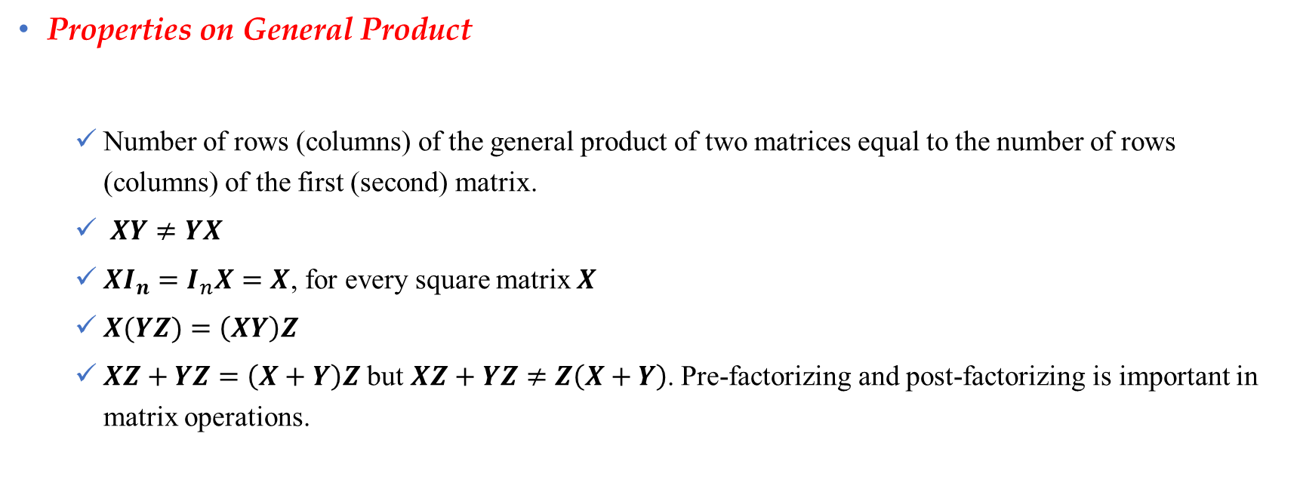
Mathematical operations on matrix (Cont’d)
Properties on General Product
Number of rows (columns) of the general product of two matrices equal to the number of rows (columns) of the first (second) matrix.
$XY≠YX$
$XI_{n}=I_{n}X=X$, for every square matrix $X$
$X(YZ)=\left(XY\right)Z$
$XZ+YZ=\left(X+Y\right)Z$ but $XZ+YZ≠Z\left(X+Y\right)$. Pre-factorizing and post-factorizing is important in matrix operations.
Data Science & Machine Learning in Finance: Matrix Calculus
University of Glasgow
2022-2023

Slide 22
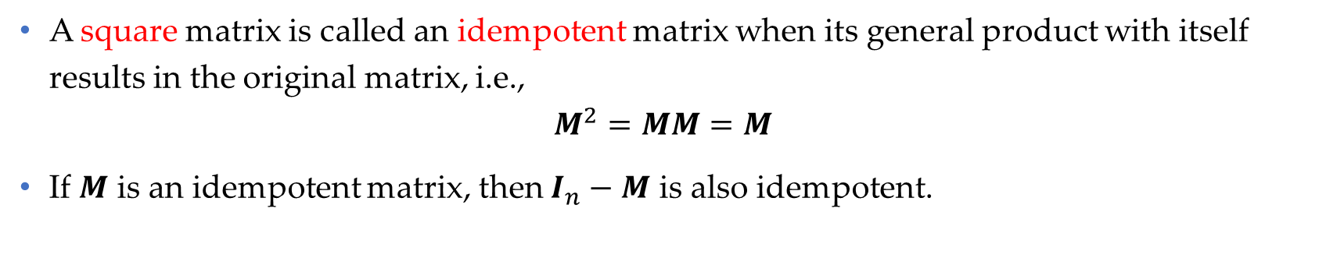
Idempotent matrix
A square matrix is called an idempotent matrix when its general product with itself results in the original matrix, i.e.,
$$M^{2}=MM=M$$
If $M$ is an idempotent matrix, then $I_{n}−M$ is also idempotent.
Data Science & Machine Learning in Finance: Matrix Calculus
University of Glasgow
2022-2023

Slide 23

Transpose of a matrix
Transpose of matrix $X$ is denoted by $X^{′}$ or $X^{T}$
Transpose operator switches row and column identifiers, for example:
$$X=\left[\begin{matrix}−2 & 1 & 3 \\ 0 & 1 & 5\end{matrix}\right] ⇒ X^{′}=\left[\begin{matrix}−2 & 0 \\ 1 & 1 \\ 3 & 5\end{matrix}\right]$$
Data Science & Machine Learning in Finance: Matrix Calculus
University of Glasgow
2022-2023

Slide 24
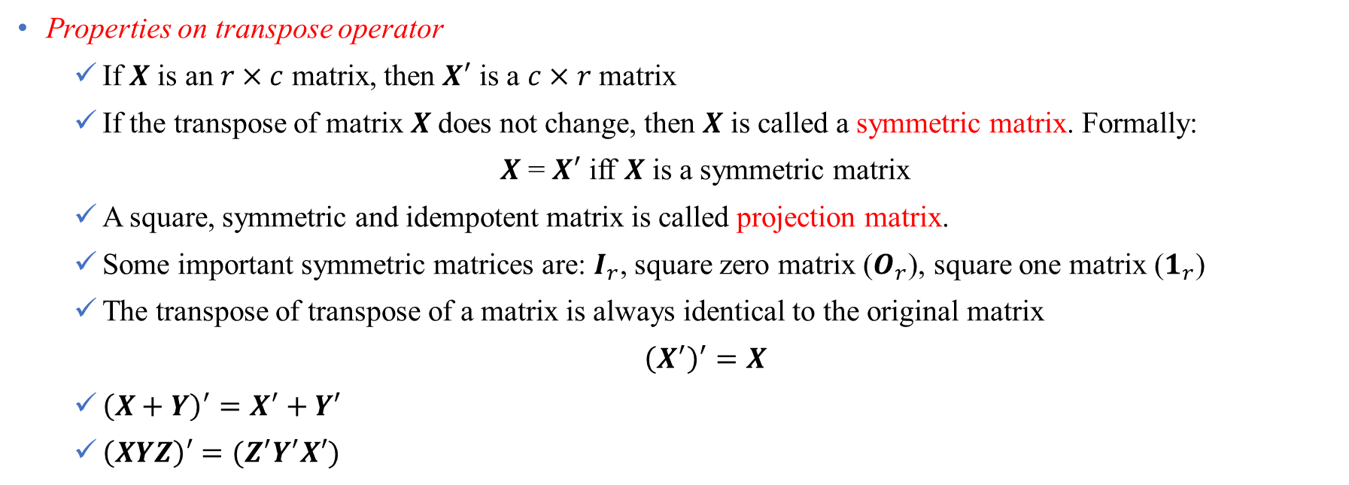
Transpose of a matrix (Cont’d)
Properties on transpose operator
If $X$ is an $r×c$ matrix, then $X^{′}$ is a $c×r$ matrix
If the transpose of matrix $X$does not change, then $X$ is called a symmetric matrix. Formally:
$X$ = $X^{′}$ iff $X$ is a symmetric matrix
A square, symmetric and idempotent matrix is called projection matrix.
Some important symmetric matrices are: $I_{r}$, square zero matrix ($O_{r}$), square one matrix ($1_{r}$)
The transpose of transpose of a matrix is always identical to the original matrix
${\left(X^{′}\right)}^{′}=X$
${\left(X+Y\right)}^{′}=X^{′}+Y′$
$\left(XYZ\right)′=(Z^{′}Y^{′}X′)$
Data Science & Machine Learning in Finance: Matrix Calculus
University of Glasgow
2022-2023

Slide 25
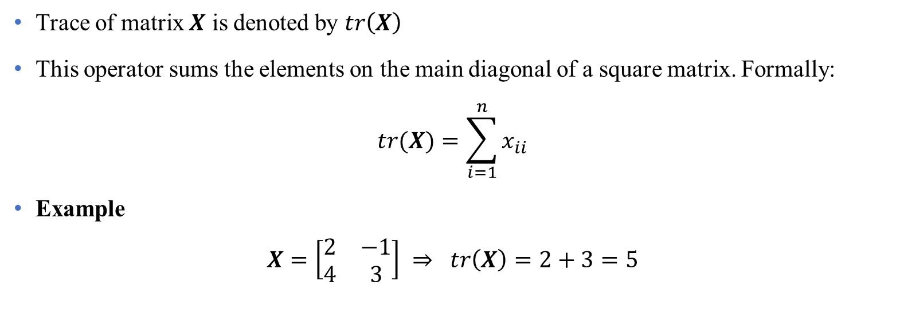
Trace of a matrix
Trace of matrix $X$ is denoted by $tr\left(X\right)$
This operator sums the elements on the main diagonal of a square matrix. Formally:
$$tr(X)=\sum_{i=1}^{n}{x_{ii}}$$
Example
$$X=\left[\begin{matrix}2 & −1 \\ 4 & 3\end{matrix}\right] ⇒ tr\left(X\right)=2+3=5$$
Data Science & Machine Learning in Finance: Matrix Calculus
University of Glasgow
2022-2023

Slide 26
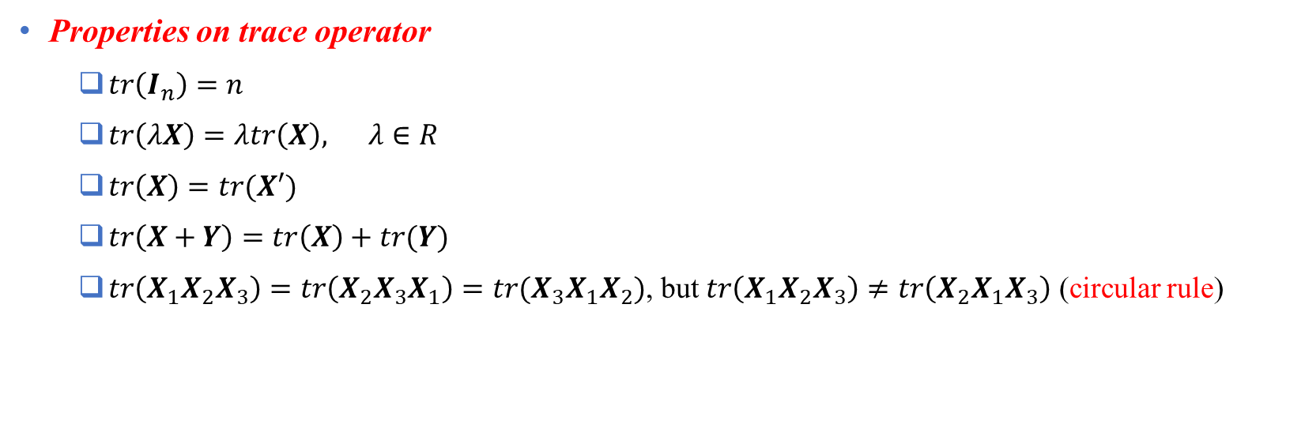
Trace of a matrix (Cont’d)
Properties on trace operator
$tr\left(I_{n}\right)=n$
$tr\left(λX\right)=λtr\left(X\right), λ∈R$
$tr\left(X\right)=tr(X′)$
$tr\left(X+Y\right)=tr\left(X\right)+tr(Y)$
$tr\left(X_{1}X_{2}X_{3}\right)=tr\left(X_{2}X_{3}X_{1}\right)=tr(X_{3}X_{1}X_{2})$, but $tr\left(X_{1}X_{2}X_{3}\right)≠tr\left(X_{2}X_{1}X_{3}\right)$ (circular rule)
Data Science & Machine Learning in Finance: Matrix Calculus
University of Glasgow
2022-2023

Slide 27
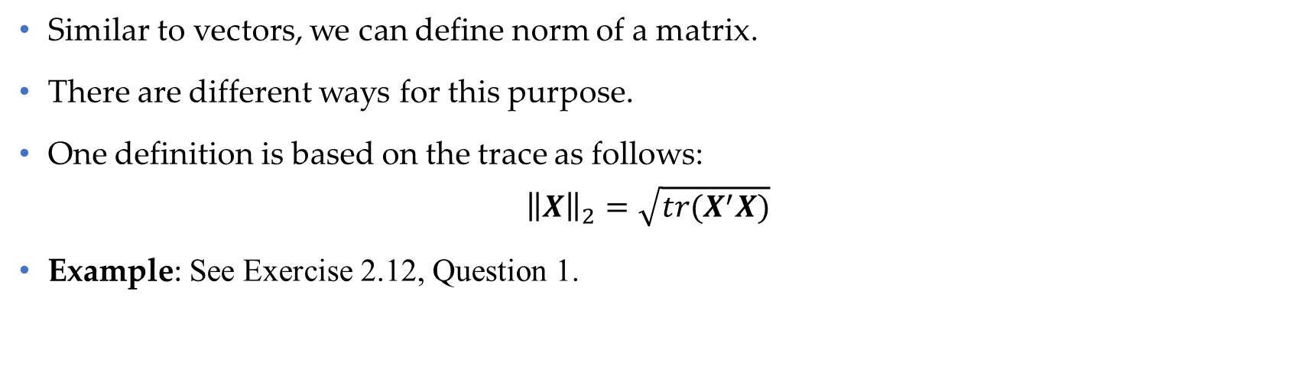
Norm of a matrix
Similar to vectors, we can define norm of a matrix.
There are different ways for this purpose.
One definition is based on the trace as follows:
$${\left\|X\right\|}_{2}=\sqrt{tr(X^{′}X)}$$
Example: See Exercise 2.12, Question 1.
Data Science & Machine Learning in Finance: Matrix Calculus
University of Glasgow
2022-2023

Slide 28
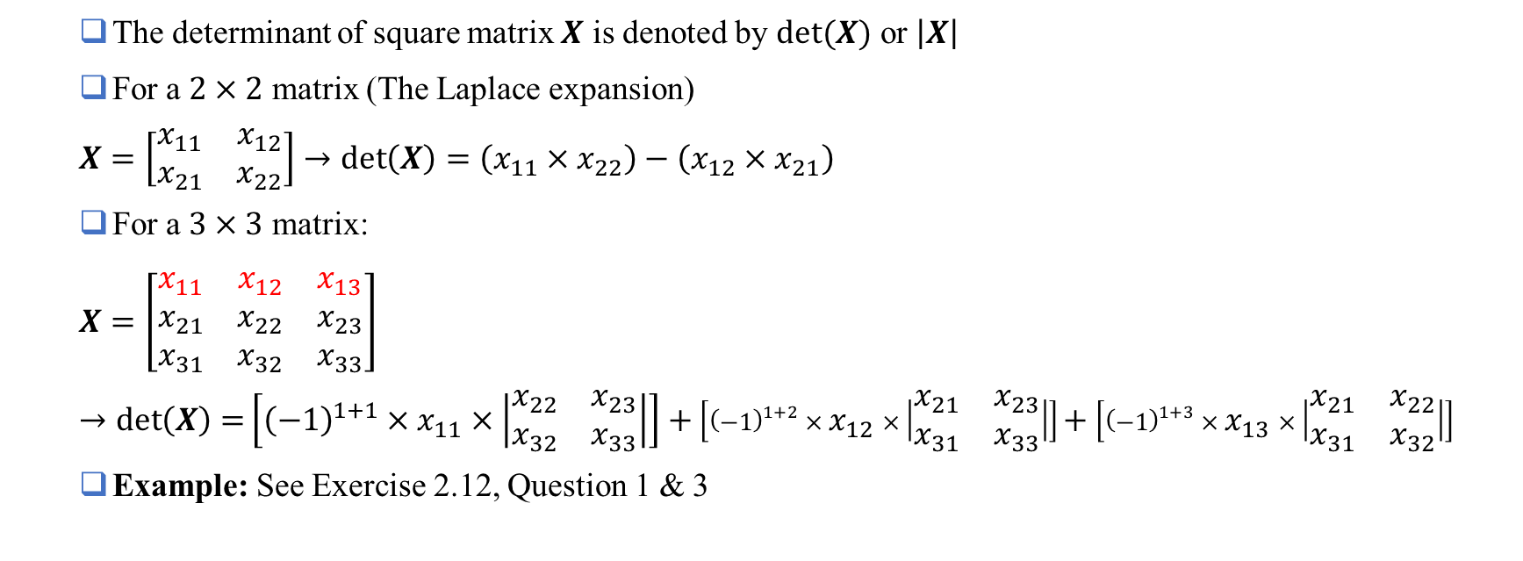
Determinant
The determinant of square matrix $X$ is denoted by $det⁡(X)$ or $\left|X\right|$
For a $2×2$ matrix (The Laplace expansion)
$$X=\left[\begin{matrix}x_{11} & x_{12} \\ x_{21} & x_{22}\end{matrix}\right]→\det\left(X\right)=\left(x_{11}{×x}_{22}\right)−\left(x_{12}{×x}_{21}\right)$$
For a $3×3$ matrix:
$$X=\left[\begin{matrix}x_{11} & x_{12} & x_{13} \\ x_{21} & x_{22} & x_{23} \\ x_{31} & x_{32} & x_{33}\end{matrix}\right]→\det\left(X\right)=\left[{\left(−1\right)}^{1+1}×x_{11}×\left|\begin{matrix}x_{22} & x_{23} \\ x_{32} & x_{33}\end{matrix}\right|\right]+\left[{\left(−1\right)}^{1+2}×x_{12}×\left|\begin{matrix}x_{21} & x_{23} \\ x_{31} & x_{33}\end{matrix}\right|\right]+\left[{\left(−1\right)}^{1+3}×x_{13}×\left|\begin{matrix}x_{21} & x_{22} \\ x_{31} & x_{32}\end{matrix}\right|\right]$$
Example: See Exercise 2.12, Question 1 & 3
Data Science & Machine Learning in Finance: Matrix Calculus
University of Glasgow
2022-2023

Slide 29
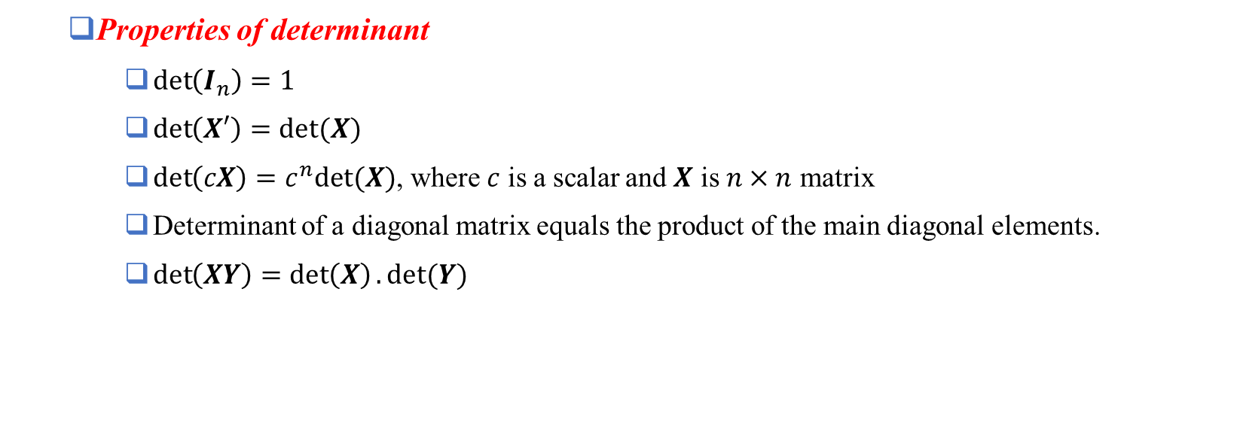
Determinant (Cont’d)
Properties of determinant
$\det\left(I_{n}\right)=1$
$\det\left(X′\right)=det⁡(X)$
$\det\left(cX\right)=c^{n}det⁡(X)$, where $c$ is a scalar and $X$ is $n×n$ matrix
Determinant of a diagonal matrix equals the product of the main diagonal elements.
$\det\left(XY\right)=\det\left(X\right).det⁡(Y)$
Data Science & Machine Learning in Finance: Matrix Calculus
University of Glasgow
2022-2023

Slide 30
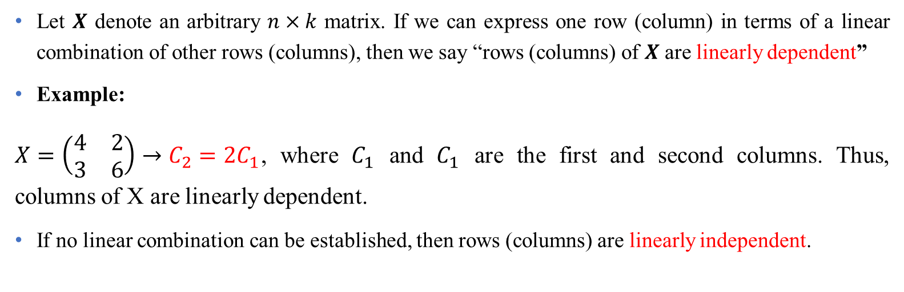
Linear dependence
Let $X$ denote an arbitrary $n×k$ matrix. If we can express one row (column) in terms of a linear combination of other rows (columns), then we say “rows (columns) of $X$ are linearly dependent”
Example:
$X=\left(\begin{matrix}4 & 2 \\ 3 & 6\end{matrix}\right)→C_{2}=2C_{1}$, where $C_{1}$ and $C_{1}$ are the first and second columns. Thus, columns of X are linearly dependent.
If no linear combination can be established, then rows (columns) are linearly independent.
Note: A linear combination is multiplying one row (column) by a scalar and add to another row (column).
Data Science & Machine Learning in Finance: Matrix Calculus
University of Glasgow
2022-2023

Slide 31
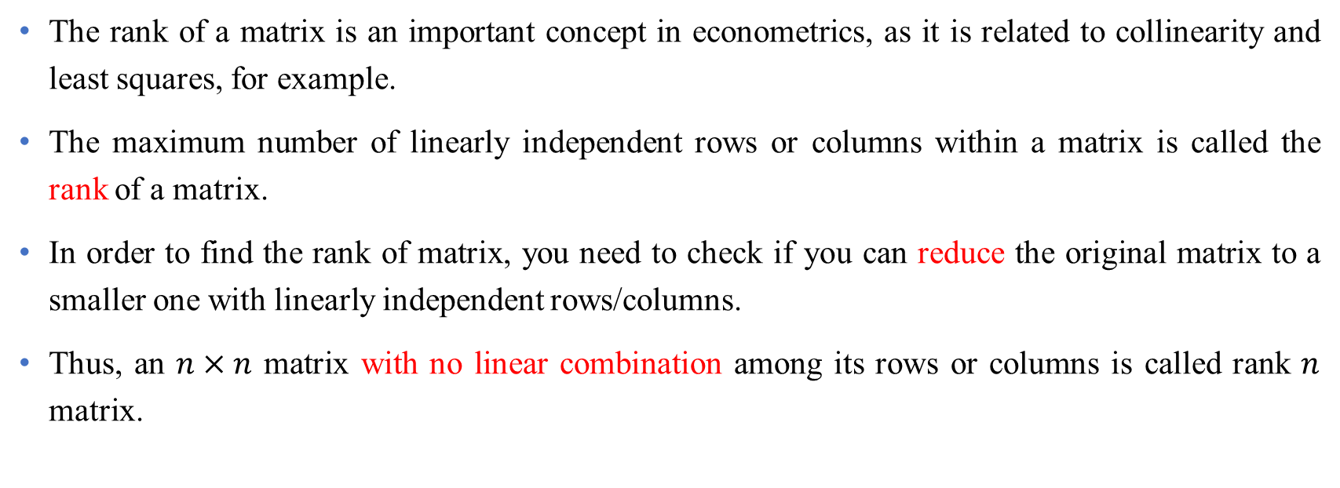
Rank of a matrix
The rank of a matrix is an important concept in econometrics, as it is related to collinearity and least squares, for example.
The maximum number of linearly independent rows or columns within a matrix is called the rank of a matrix.
In order to find the rank of matrix, you need to check if you can reduce the original matrix to a smaller one with linearly independent rows/columns.
Thus, an $n×n$ matrix with no linear combination among its rows or columns is called rank $n$ matrix.
Note: Matrix reduction means creating zero rows (columns) by linear combinations and removing them from the original matrix
Data Science & Machine Learning in Finance: Matrix Calculus
University of Glasgow
2022-2023

Slide 32
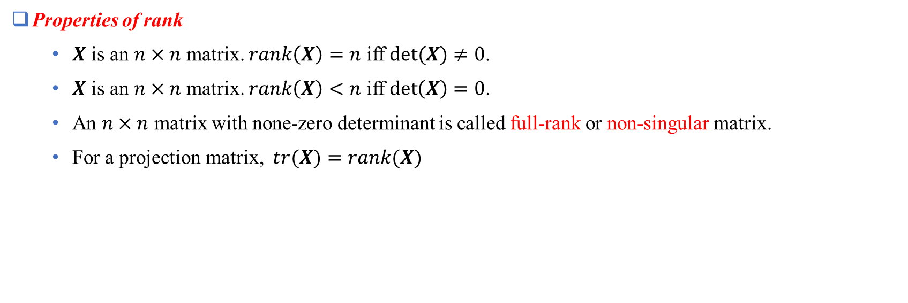
Rank of a matrix (Cont’d)
Properties of rank
$X$ is an $n×n$ matrix. $rank\left(X\right)=n$ iff $det⁡(X)≠0$.
$X$ is an $n×n$ matrix. $rank\left(X\right)<n$ iff $\det\left(X\right)=0$.
An $n×n$ matrix with none-zero determinant is called full-rank or non-singular matrix.
For a projection matrix, $tr(X)=rank(X)$
Data Science & Machine Learning in Finance: Matrix Calculus
University of Glasgow
2022-2023

Slide 33
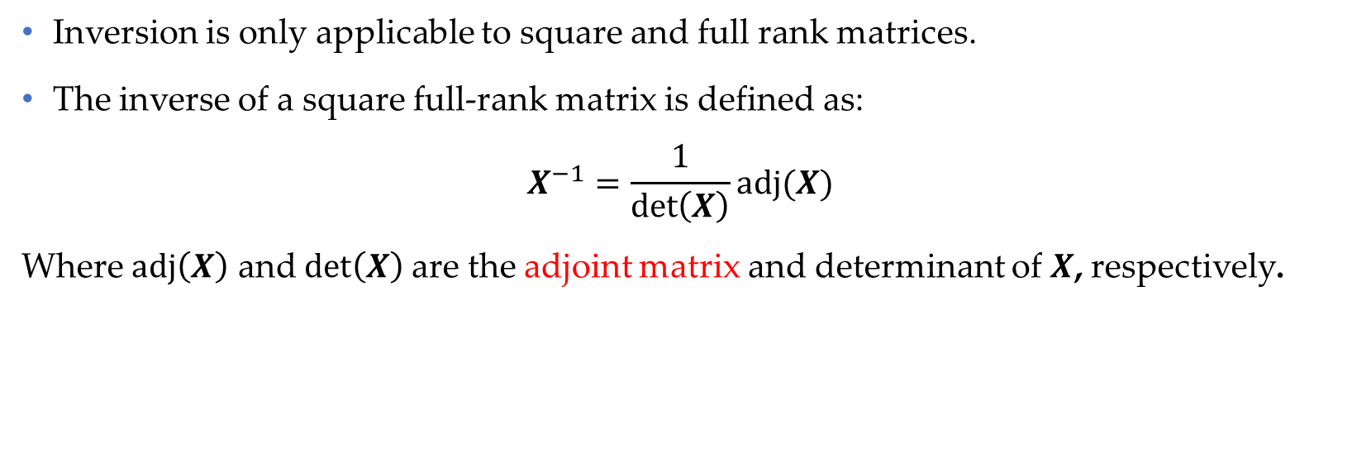
Inversion
Inversion is only applicable to square and full rank matrices.
The inverse of a square full-rank matrix is defined as:
$$X^{−1}=\frac{1}{\det\left(X\right)}adj(X)$$
Where $adj\left(X\right)$ and $det\left(X\right)$are the adjoint matrix and determinant of $X$, respectively.
Data Science & Machine Learning in Finance: Matrix Calculus
University of Glasgow
2022-2023

Slide 34
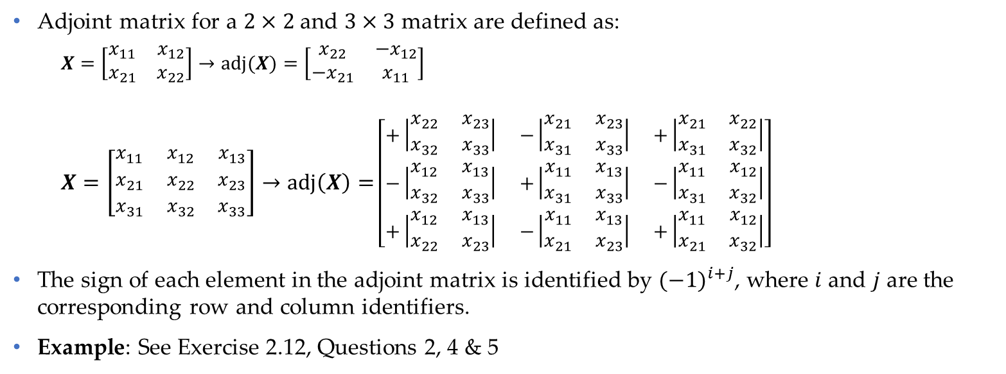
Inversion (Cont’d)
Adjoint matrix for a $2×2$ and $3×3$ matrix are defined as:
$$X=\left[\begin{matrix}x_{11} & x_{12} \\ x_{21} & x_{22}\end{matrix}\right]→adj(X)=\left[\begin{matrix}x_{22} & {−x}_{12} \\ {−x}_{21} & x_{11}\end{matrix}\right]$$
$$X=\left[\begin{matrix}x_{11} & x_{12} & x_{13} \\ x_{21} & x_{22} & x_{23} \\ x_{31} & x_{32} & x_{33}\end{matrix}\right]→\operatorname{adj}\left(X\right)=\left[\begin{matrix}+\left|\begin{matrix}x_{22} & x_{23} \\ x_{32} & x_{33}\end{matrix}\right| & −\left|\begin{matrix}x_{21} & x_{23} \\ x_{31} & x_{33}\end{matrix}\right| & +\left|\begin{matrix}x_{21} & x_{22} \\ x_{31} & x_{32}\end{matrix}\right| \\ −\left|\begin{matrix}x_{12} & x_{13} \\ x_{32} & x_{33}\end{matrix}\right| & +\left|\begin{matrix}x_{11} & x_{13} \\ x_{31} & x_{33}\end{matrix}\right| & −\left|\begin{matrix}x_{11} & x_{12} \\ x_{31} & x_{32}\end{matrix}\right| \\ +\left|\begin{matrix}x_{12} & x_{13} \\ x_{22} & x_{23}\end{matrix}\right| & −\left|\begin{matrix}x_{11} & x_{13} \\ x_{21} & x_{23}\end{matrix}\right| & +\left|\begin{matrix}x_{11} & x_{12} \\ x_{21} & x_{32}\end{matrix}\right|\end{matrix}\right]$$
The sign of each element in the adjoint matrix is identified by ${(−1)}^{i+j}$, where $i$ and $j$ are the corresponding row and column identifiers.
Example: See Exercise 2.12, Questions 2, 4 & 5
Data Science & Machine Learning in Finance: Matrix Calculus
University of Glasgow
2022-2023

Slide 35
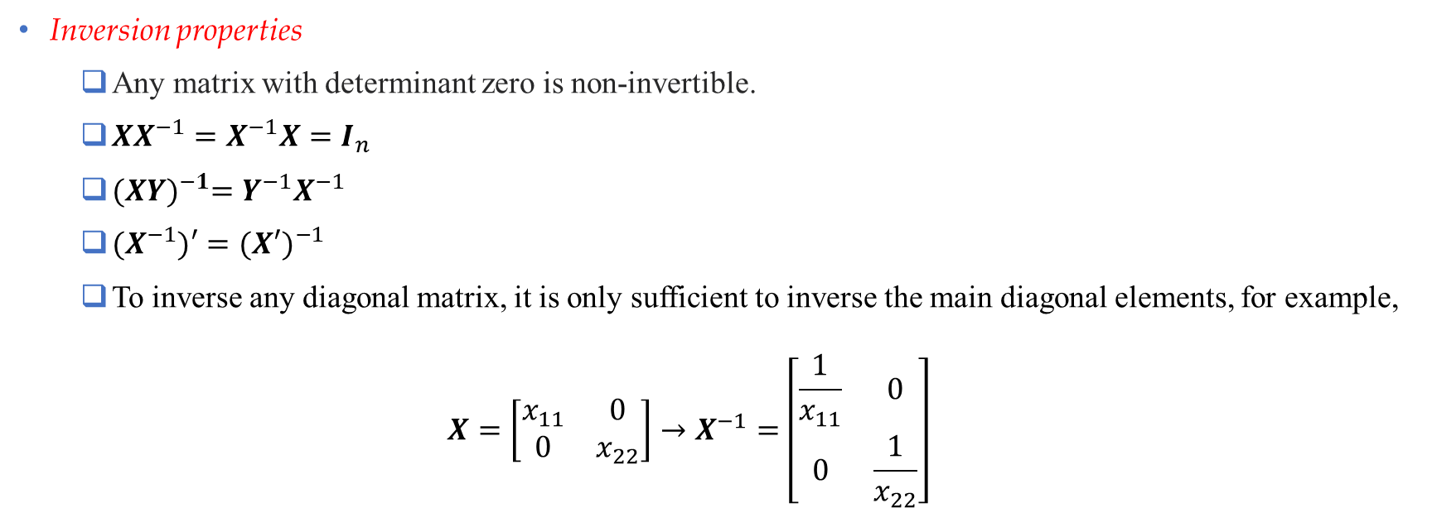
Inversion (Cont’d)
Inversion properties
Any matrix with determinant zero is non-invertible.
$XX^{−1}={X^{−1}X=I}_{n}$
${(XY)}^{−1}=Y^{−1}X^{−1}$
${(X}^{−1})′={(X′)}^{−1}$
To inverse any diagonal matrix, it is only sufficient to inverse the main diagonal elements, for example,
$$X=\left[\begin{matrix}x_{11} & 0 \\ 0 & x_{22}\end{matrix}\right]→X^{−1}=\left[\begin{matrix}\frac{1}{x_{11}} & 0 \\ 0 & \frac{1}{x_{22}}\end{matrix}\right]$$
Data Science & Machine Learning in Finance: Matrix Calculus
University of Glasgow
2022-2023

Slide 36

Quadratic forms
The quadratic form of vector $x$is shown as:
$$F\left(x\right)=\sum_{i=1}^{n}{\sum_{j=1}^{n}{x_{i}x_{j}a_{ij}}}=x^{′}Ax$$
where $A$ is a symmetric matrix.
Quadratic function is always a scalar.
Data Science & Machine Learning in Finance: Matrix Calculus
University of Glasgow
2022-2023

Slide 37
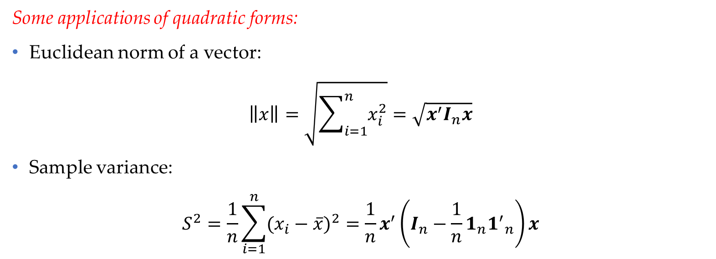
Quadratic forms (Cont’d)
Some applications of quadratic forms:
Euclidean norm of a vector:
$$\left\|x\right\|=\sqrt{\sum_{i=1}^{n}{x_{i}^{2}}}=\sqrt{x^{′}I_{n}x}$$
Sample variance:
$$S^{2}=\frac{1}{n}\sum_{i=1}^{n}{{(x_{i}−\overline{x})}^{2}}=\frac{1}{n}x^{′}\left(I_{n}−\frac{1}{n}1_{n}{1^{′}}_{n}\right)x$$
Data Science & Machine Learning in Finance: Matrix Calculus
University of Glasgow
2022-2023

Slide 38
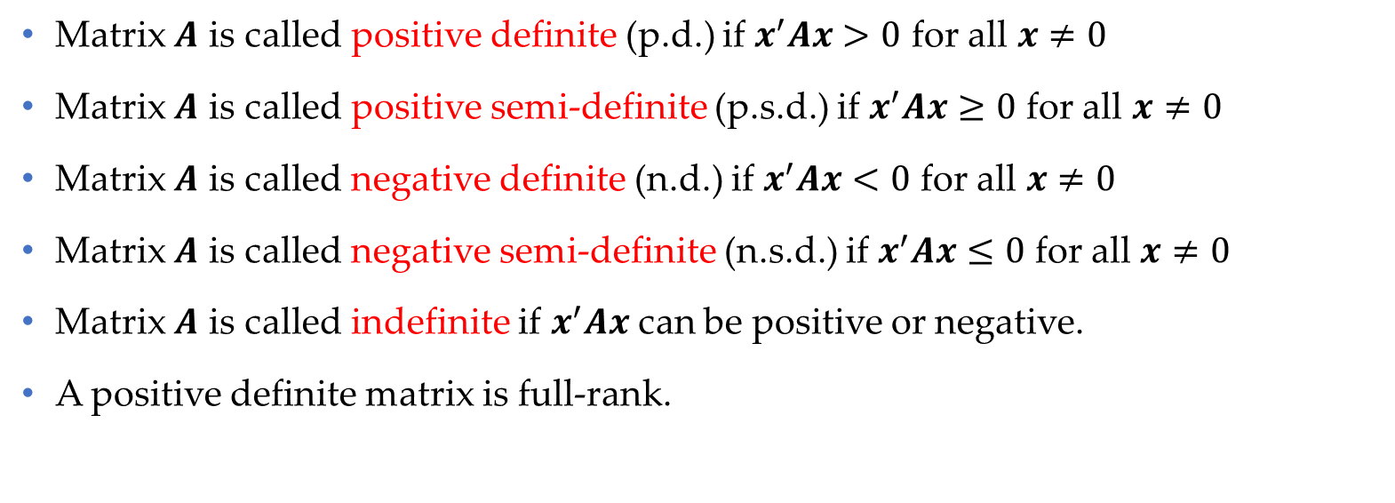
Definiteness
Matrix $A$ is called positive definite (p.d.) if $x^{′}Ax>0$ for all $x≠0$
Matrix $A$ is called positive semi-definite (p.s.d.) if $x^{′}Ax≥0$ for all $x≠0$
Matrix $A$ is called negative definite (n.d.) if $x^{′}Ax<0$ for all $x≠0$
Matrix $A$ is called negative semi-definite (n.s.d.) if $x^{′}Ax≤0$ for all $x≠0$
Matrix $A$ is called indefinite if $x^{′}Ax$ can be positive or negative.
A positive definite matrix is full-rank.
Data Science & Machine Learning in Finance: Matrix Calculus
University of Glasgow
2022-2023

Slide 39
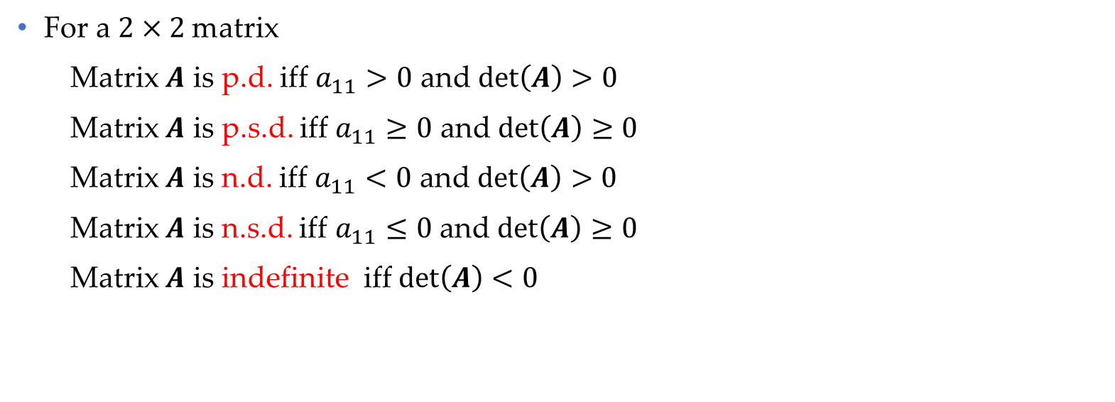
Definiteness (Cont’d)
For a $2×2$matrix
Matrix $A$ is p.d. iff $a_{11}>0$ and $\det\left(A\right)>0$
Matrix $A$ is p.s.d. iff $a_{11}≥0$ and $\det\left(A\right)≥0$
Matrix $A$ is n.d. iff $a_{11}<0$ and $\det\left(A\right)>0$
Matrix $A$ is n.s.d. iff $a_{11}≤0$ and $\det\left(A\right)≥0$
Matrix $A$ is indefinite iff $\det\left(A\right)<0$
Data Science & Machine Learning in Finance: Matrix Calculus
University of Glasgow
2022-2023

Slide 40
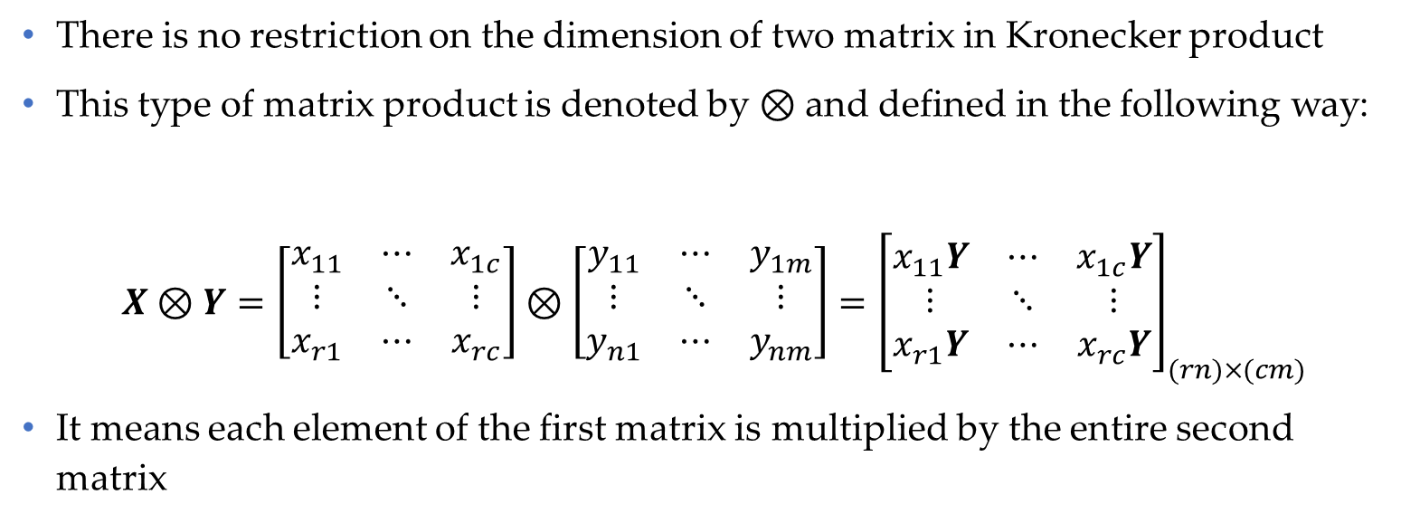
Kronecker Product
There is no restriction on the dimension of two matrix in Kronecker product
This type of matrix product is denoted by $⊗$ and defined in the following way:
$$X⊗Y=\left[\begin{matrix}x_{11} & ⋯ & x_{1c} \\ ⋮ & ⋱ & ⋮ \\ x_{r1} & ⋯ & x_{rc}\end{matrix}\right]⊗\left[\begin{matrix}y_{11} & ⋯ & y_{1m} \\ ⋮ & ⋱ & ⋮ \\ y_{n1} & ⋯ & y_{nm}\end{matrix}\right]={\left[\begin{matrix}x_{11}Y & ⋯ & x_{1c}Y \\ ⋮ & ⋱ & ⋮ \\ x_{r1}Y & ⋯ & x_{rc}Y\end{matrix}\right]}_{(rn)×(cm)}$$
It means each element of the first matrix is multiplied by the entire second matrix
Data Science & Machine Learning in Finance: Matrix Calculus
University of Glasgow
2022-2023

Slide 41
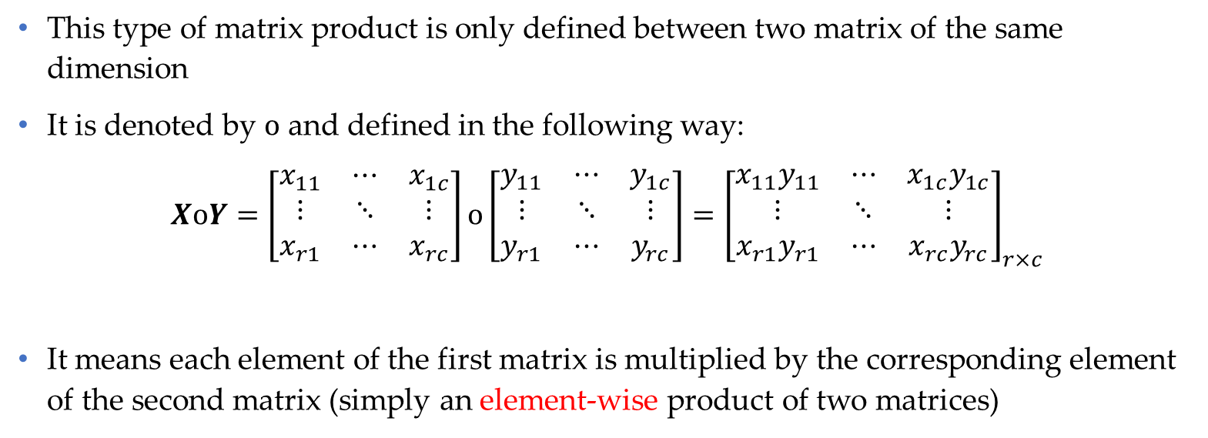
Hadamard Product
This type of matrix product is only defined between two matrix of the same dimension
It is denoted by $o$ and defined in the following way:
$$XoY=\left[\begin{matrix}x_{11} & ⋯ & x_{1c} \\ ⋮ & ⋱ & ⋮ \\ x_{r1} & ⋯ & x_{rc}\end{matrix}\right]o\left[\begin{matrix}y_{11} & ⋯ & y_{1c} \\ ⋮ & ⋱ & ⋮ \\ y_{r1} & ⋯ & y_{rc}\end{matrix}\right]={\left[\begin{matrix}x_{11}y_{11} & ⋯ & x_{1c}y_{1c} \\ ⋮ & ⋱ & ⋮ \\ x_{r1}y_{r1} & ⋯ & x_{rc}y_{rc}\end{matrix}\right]}_{r×c}$$
It means each element of the first matrix is multiplied by the corresponding element of the second matrix (simply an element-wise product of two matrices)
Data Science & Machine Learning in Finance: Matrix Calculus
University of Glasgow
2022-2023

Slide 42
Differentiation in Matrix algebra
Nine possible situations to differentiate a function in matrix algebra:
Differentiate a scalar function with respect to scalar, vector or matrix arguments
Differentiate a vector function with respect to scalar, vector or matrix arguments
Differentiate a matrix function with respect to scalar, vector or matrix arguments
We only consider differentiate:
a scalar function of vector arguments
a vector function of vector arguments
Data Science & Machine Learning in Finance: Matrix Calculus
University of Glasgow
2022-2023

Slide 43
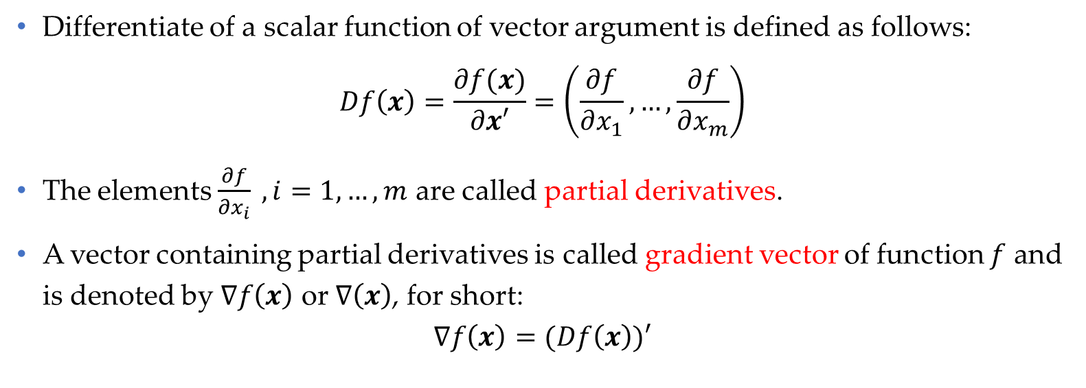
Differentiate of a scalar function of vector argument
Differentiate of a scalar function of vector argument is defined as follows:
$$Df\left(x\right)=\frac{∂f(x)}{∂x′}=\left(\frac{∂f}{∂x_{1}},…,\frac{∂f}{∂x_{m}}\right)$$
The elements $\frac{∂f}{∂x_{i}} , i=1,…,m$ are called partial derivatives.
A vector containing partial derivatives is called gradient vector of function $f$ and is denoted by $∇f\left(x\right)$ or $∇\left(x\right)$, for short:
$$∇f\left(x\right)=(Df\left(x\right))′$$
Data Science & Machine Learning in Finance: Matrix Calculus
University of Glasgow
2022-2023

Slide 44

Differentiate of a scalar function of vector argument (Cont’d)
Properties of partial derivative
$\frac{∂a^{′}x}{∂x}=\frac{∂x^{′}a}{∂x}=a$
$\frac{∂y^{′}Ax}{∂x}=y^{′}A$
$\frac{∂y^{′}Ax}{∂y}=x^{′}A′$
$\frac{∂x^{′}Ax}{∂x}=x^{′}(A+A^{′})$, for every matrix
$\frac{∂x^{′}Ax}{∂x}={2x}^{′}A$, for a symmetric matrix
$\frac{∂Ax}{∂x}=A$
Data Science & Machine Learning in Finance: Matrix Calculus
University of Glasgow
2022-2023

Slide 45
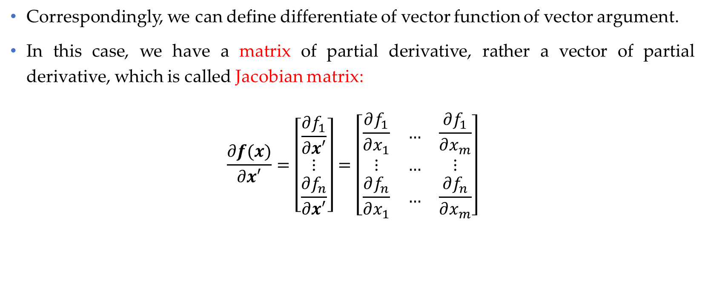
Differentiate of a vector function of vector argument
Correspondingly, we can define differentiate of vector function of vector argument.
In this case, we have a matrix of partial derivative, rather a vector of partial derivative, which is called Jacobian matrix:
$$\frac{∂f(x)}{∂x′}=\left[\begin{matrix}\frac{∂f_{1}}{∂x′} \\ ⋮ \\ \frac{∂f_{n}}{∂x′}\end{matrix}\right]=\left[\begin{matrix}\frac{∂f_{1}}{∂x_{1}} & … & \frac{∂f_{1}}{∂x_{m}} \\ ⋮ & … & ⋮ \\ \frac{∂f_{n}}{∂x_{1}} & … & \frac{∂f_{n}}{∂x_{m}}\end{matrix}\right]$$
Data Science & Machine Learning in Finance: Matrix Calculus
University of Glasgow
2022-2023

Slide 46
Section 3
Ordinary Least Squares
(OLS)

Slide 47
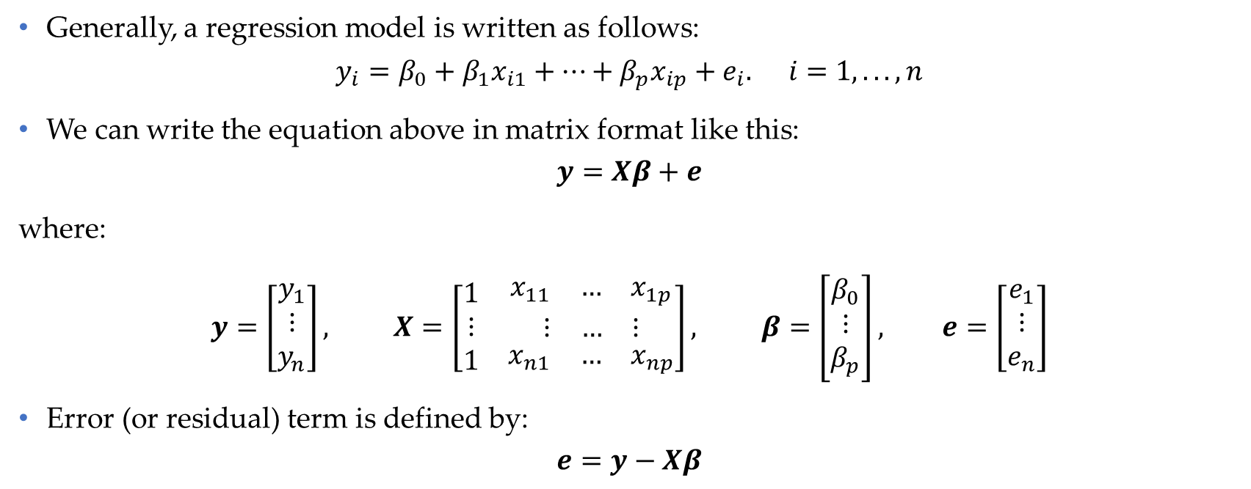
Ordinary least squares (OLS)- set up
Generally, a regression model is written as follows:
$$y_{i}=β_{0}+β_{1}x_{i1}+…+β_{p}x_{ip}+e_{i}. i=1,...,n$$
We can write the equation above in matrix format like this:
$$y=Xβ+e$$
where:
$$y=\left[\begin{matrix}y_{1} \\ ⋮ \\ y_{n}\end{matrix}\right], X=\left[\begin{matrix}1 & \begin{matrix}x_{11} & … & x_{1p}\end{matrix} \\ ⋮ & \begin{matrix}⋮ & … & ⋮\end{matrix} \\ 1 & \begin{matrix}x_{n1} & … & x_{np}\end{matrix}\end{matrix}\right], β=\left[\begin{matrix}β_{0} \\ ⋮ \\ β_{p}\end{matrix}\right], e=\left[\begin{matrix}e_{1} \\ ⋮ \\ e_{n}\end{matrix}\right]$$
Error (or residual) term is defined by:
$$e=y−Xβ$$
Data Science & Machine Learning in Finance: Matrix Calculus
University of Glasgow
2022-2023

Slide 48

Ordinary least squares (OLS)- set up
In theory, OLS estimator (i.e., $\hat{β}$) minimizes the residual sum of squares (RSS):
$$Q=\sum_{i=1}^{n}{e_{i}^{2}}=e_{1}^{2}+…+e_{n}^{2}$$
Using matrix notation:
$$Q=e^{′}e=(y−Xβ)′(y−Xβ)$$
Data Science & Machine Learning in Finance: Matrix Calculus
University of Glasgow
2022-2023

Slide 49
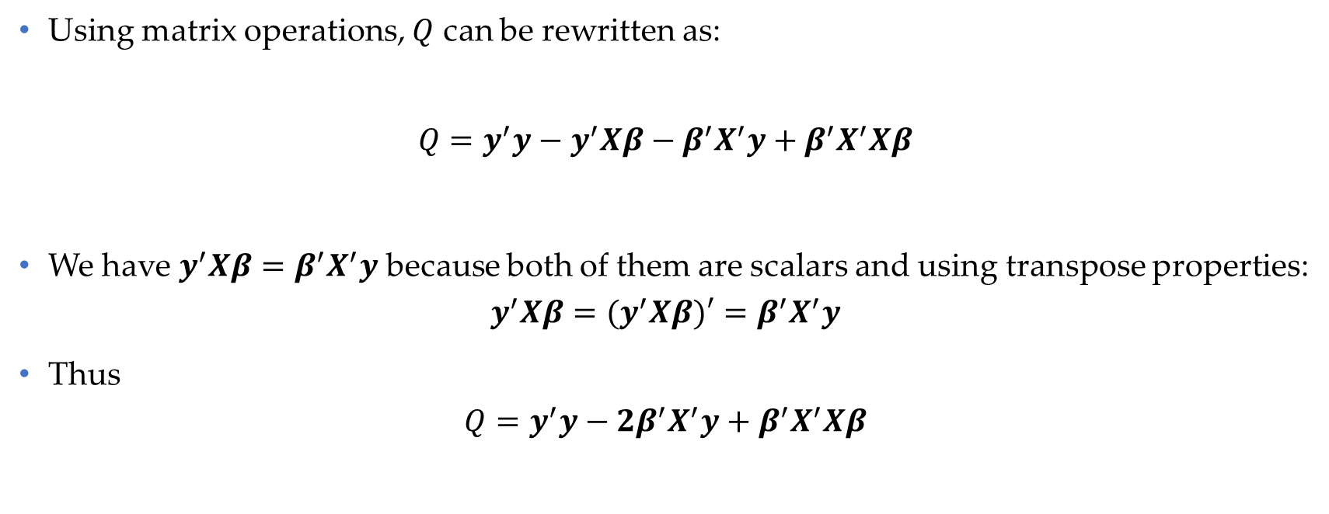
Ordinary least squares (OLS)- set up
Using matrix operations, $Q$ can be rewritten as:
$${Q=y}^{′}y−y^{′}Xβ−β^{′}X^{′}y+β^{′}X^{′}Xβ$$
We have $y^{′}Xβ=β^{′}X^{′}y$ because both of them are scalars and using transpose properties:
$$y^{′}Xβ=(y^{′}Xβ)′=β^{′}X^{′}y$$
Thus
$${Q=y}^{′}y−2β^{′}X^{′}y+β^{′}X^{′}Xβ$$
Data Science & Machine Learning in Finance: Matrix Calculus
University of Glasgow
2022-2023

Slide 50
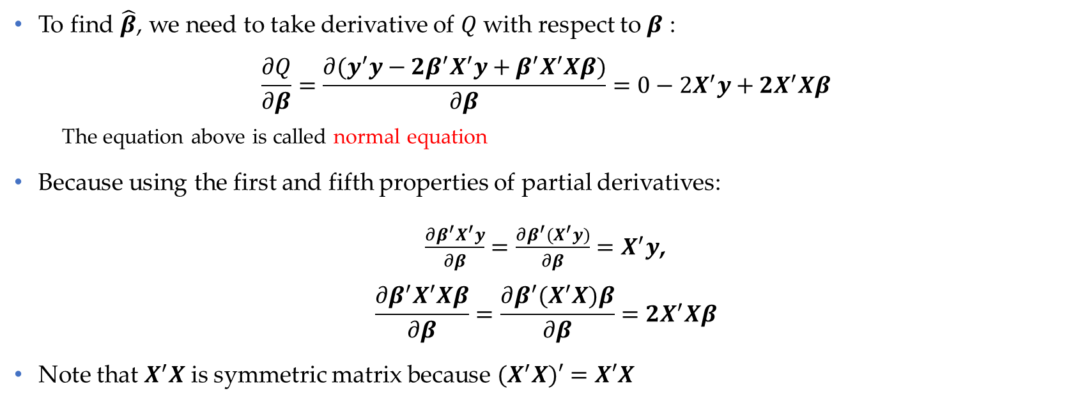
Ordinary least squares (OLS)- solution
To find $\hat{β}$, we need to take derivative of $Q$ with respect to $β$ :
$$\frac{∂Q}{∂β}=\frac{∂{(y}^{′}y−2β^{′}X^{′}y+β^{′}X^{′}Xβ)}{∂β}=0−2X^{′}y+2X^{′}Xβ$$
The equation above is called normal equation
Because using the first and fifth properties of partial derivatives:
$\frac{∂β^{′}X^{′}y}{∂β}=\frac{∂β^{′}{(X}^{′}y)}{∂β}=X^{′}y$,
$$\frac{∂β^{′}X^{′}Xβ}{∂β}=\frac{∂β^{′}{(X}^{′}X)β}{∂β}={2X}^{′}Xβ$$
Note that $X^{′}X$ is symmetric matrix because ${(X}^{′}X)′=X′X$
Data Science & Machine Learning in Finance: Matrix Calculus
University of Glasgow
2022-2023

Slide 51
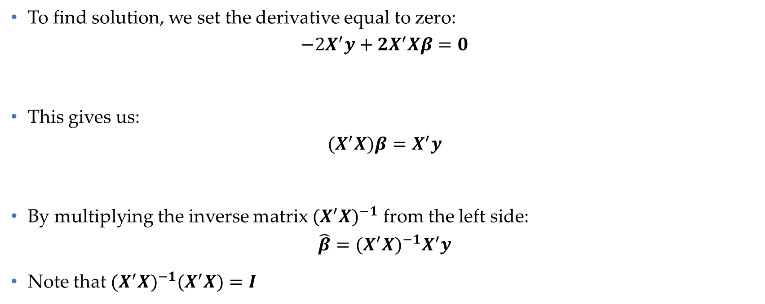
Ordinary least squares (OLS)- solution
To find solution, we set the derivative equal to zero:
$$−2X^{′}y+2X^{′}Xβ=0$$
This gives us:
$${(X}^{′}X)β=X^{′}y$$
By multiplying the inverse matrix ${(X^{′}X)}^{−1}$ from the left side:
$$\hat{β}={(X^{′}X)}^{−1}X^{′}y$$
Note that ${{(X^{′}X)}^{−1}(X}^{′}X)=I$
Data Science & Machine Learning in Finance: Matrix Calculus
University of Glasgow
2022-2023

Slide 52
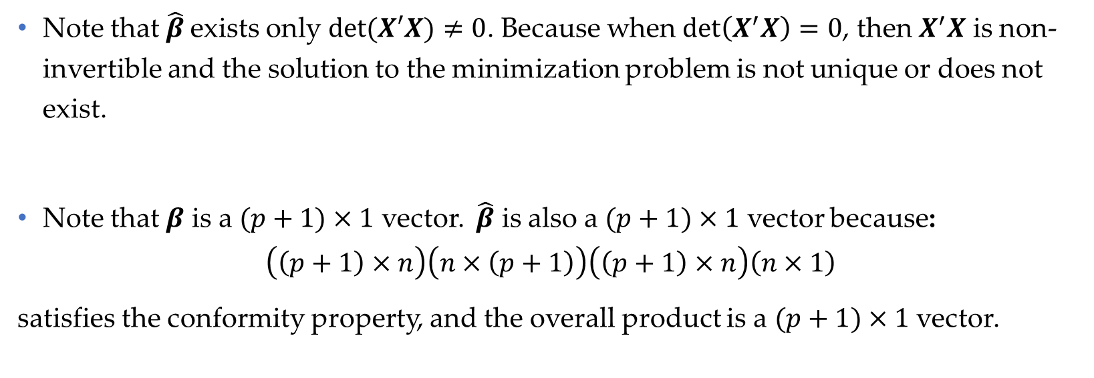
Ordinary least squares (OLS)- solution
Note that $\hat{β}$exists only $det⁡(X′X)≠0$. Because when $\det\left(X^{′}X\right)=0$, then $X^{′}X$ is non-invertible and the solution to the minimization problem is not unique or does not exist.
Note that $β$ is a $(p+1)×1$ vector. $\hat{β}$ is also a $(p+1)×1$ vector because:
$$\left(\left(p+1\right)×n\right)\left(n×\left(p+1\right)\right)\left(\left(p+1\right)×n\right)\left(n×1\right)$$
satisfies the conformity property, and the overall product is a $(p+1)×1$ vector.
Data Science & Machine Learning in Finance: Matrix Calculus
University of Glasgow
2022-2023

Slide 53
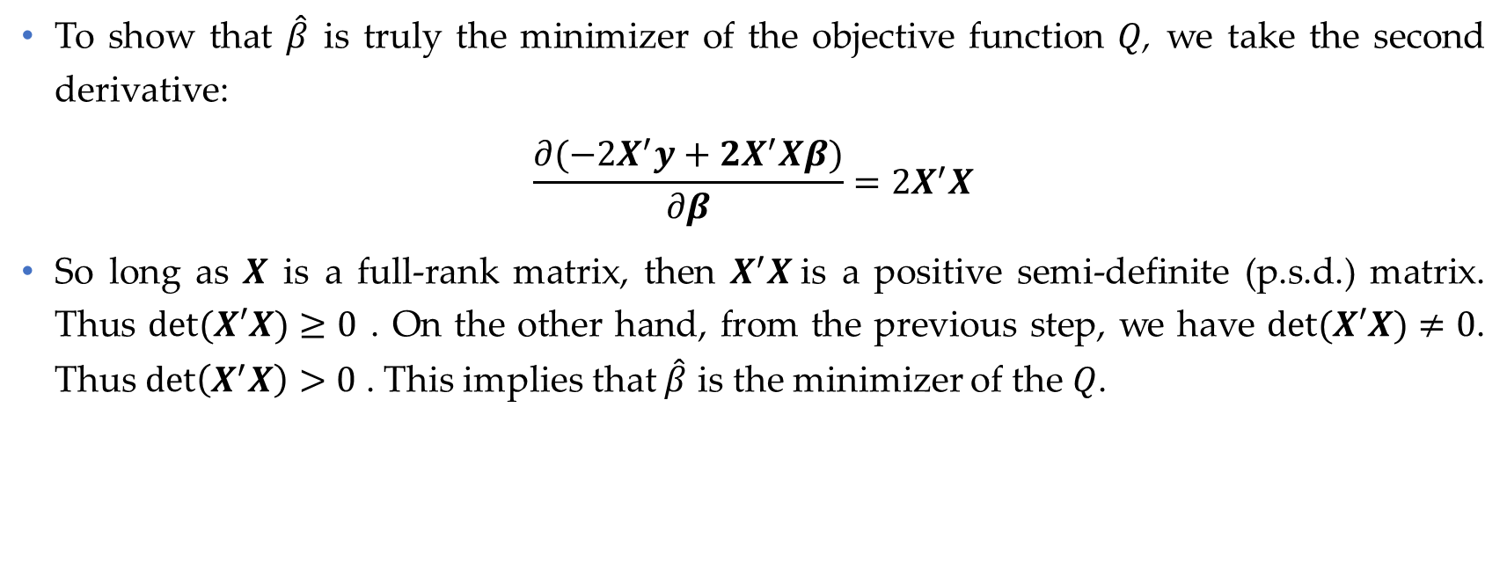
Ordinary least squares (OLS)- solution
To show that $\hat{β}$ is truly the minimizer of the objective function $Q$, we take the second derivative:
$$\frac{∂(−2X^{′}y+2X^{′}Xβ)}{∂β}=2X^{′}X$$
So long as $X$ is a full-rank matrix, then $X^{′}X$is a positive semi-definite (p.s.d.) matrix. Thus $det⁡(X′X)≥0$ . On the other hand, from the previous step, we have $det⁡(X′X)≠0$. Thus $\det\left(X^{′}X\right)>0$ . This implies that $\hat{β}$ is the minimizer of the $Q$.
Data Science & Machine Learning in Finance: Matrix Calculus
University of Glasgow
2022-2023

Slide 54
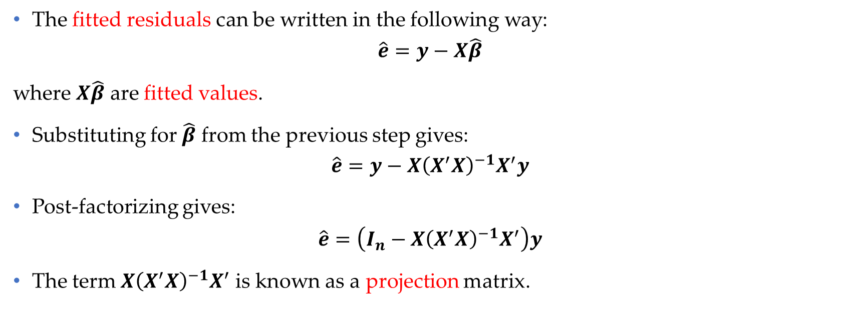
Ordinary least squares (OLS)- fitted residuals
The fitted residuals can be written in the following way:
$$\hat{e}=y−X\hat{β}$$
where $X\hat{β}$ are fitted values.
Substituting for $\hat{β}$ from the previous step gives:
$$\hat{e}=y−X{\left(X^{′}X\right)}^{−1}X^{′}y$$
Post-factorizing gives:
$$\hat{e}=\left(I_{n}−X{\left(X^{′}X\right)}^{−1}X^{′}\right)y$$
The term $X{\left(X^{′}X\right)}^{−1}X^{′}$ is known as a projection matrix.
Data Science & Machine Learning in Finance: Matrix Calculus
University of Glasgow
2022-2023

